Slide 1
RED BLACK TREE

Slide 2
binary search trees
Ordered, or sorted, binary trees.
Nodes can have 2 subtrees.
Items to the left of a given node are smaller.
Items to the right of a given node are larger.

Slide 3
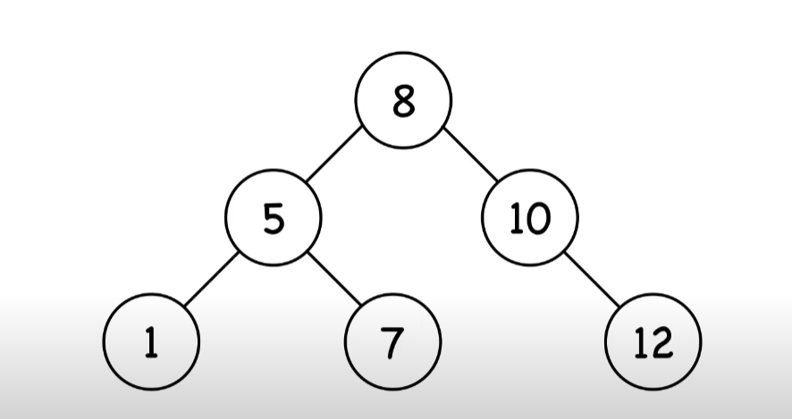

Slide 4
red-black tree
A node is either red or black.
The root and leaves (NIL) are black.
If a node is red, then its children are black.
All paths from a node to its NIL descendants contain the same number of black nodes.

Slide 5
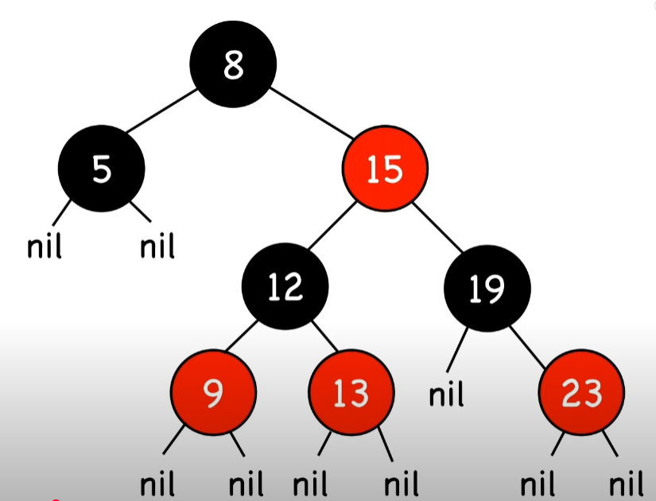
red-black tree

Slide 6
red-black tree
Nodes require one storage bit to keep track of color.
The longest path (root to farthest NIL) is no more than twice the length of the shortest path (root to nearest NIL).
Shortest path: all black nodes
Longest path: alternating red and black

Slide 7
operations
Search
Insert and Delete require rotation and recoloring

Slide 8
time complexity, space complexity
Search O(log n)
Insert O(log n)
Remove O(log n)
Space Complexity O(n)

Slide 9
rotation
Alters the structure of a tree by rearranging subtrees
Goal is to decrease the height of the tree
Red-black trees- maximum height of O(log n)
Larger subtrees up, smaller subtrees down
Does not affect the order of elements

Slide 10
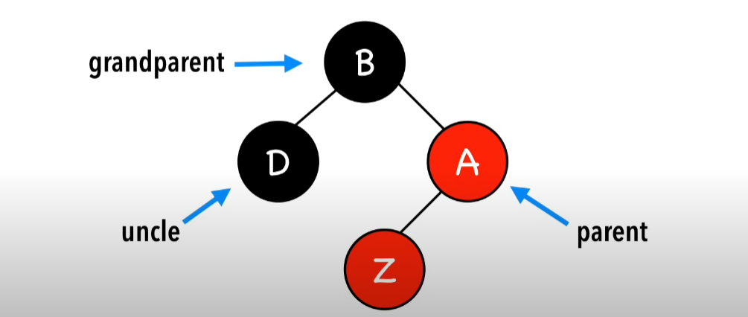
Z NODE’S relationship

Slide 11
INSERTION
Insert Z and color it red
Recolor and rotate nodes to fix violation
4 scenarios
Z = root
Z.uncle = red
Z.uncle = black (triangle)
Z.uncle = black (line)

Slide 12
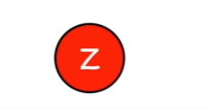

CASE 1
Z = root - color black

Slide 13
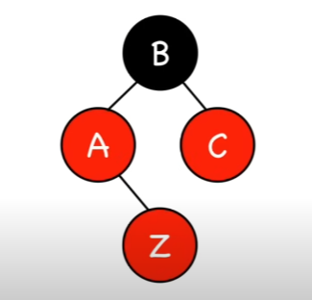
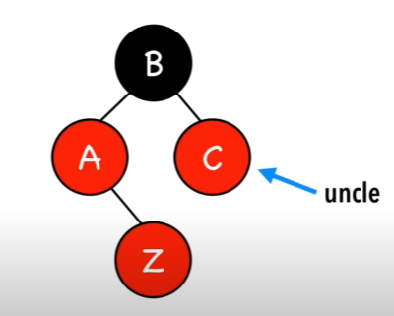
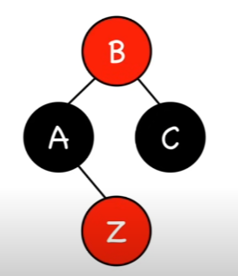
Case 2
Z.uncle = red – recolor

Slide 14
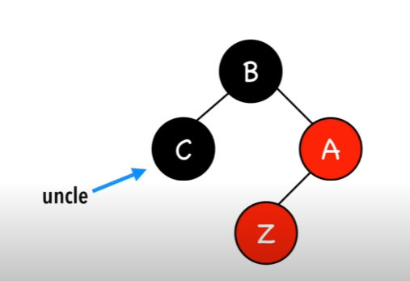
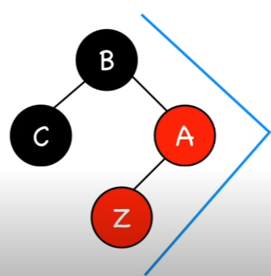
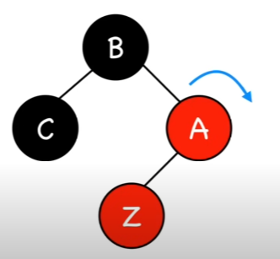
CASE 3
Z.uncle = black (triangle) –Double rotate Z.parent

Slide 15
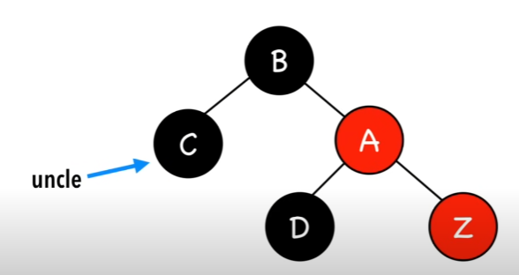
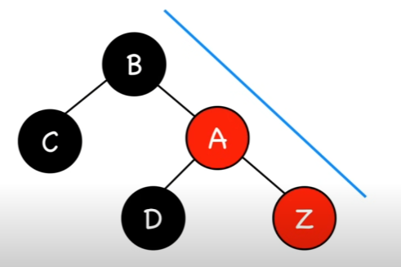
Case 4
Z.uncle = black (line) –rotate Z’s grandparent and recolor

Slide 16
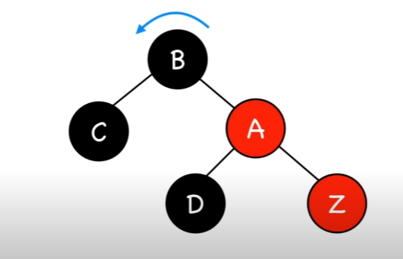
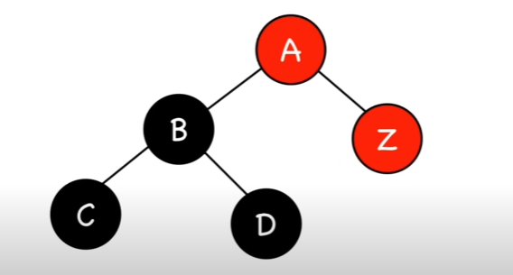
Case 4 -rotation

Slide 17
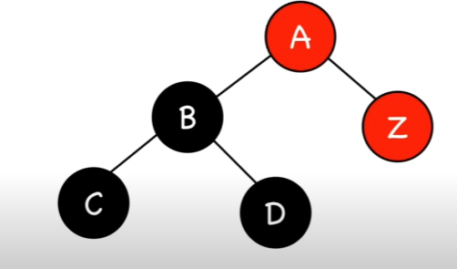
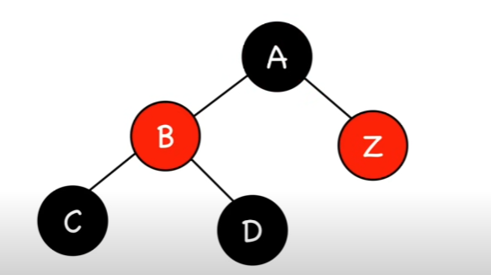
CASE 4 -RECOLOR

Slide 18
4 scenarios
Z = root -> color black
Z.uncle = red -> recolor
Z.uncle = black (triangle) -> rotate Z.parent
Z.uncle = black (line) -> rotate Z.grandparent & recolor

Slide 19
SEARCH
Starts at the root of the tree and compares the search key with the current node's key.
If the key matches, it returns the value of the current node.
If the key is smaller, it moves to the left subtree.
If the key is larger, it moves to the right subtree.
If it reaches a None node, the key is not present in the tree.

Slide 20
DELETION
Search for the Node
Find the node containing the key to be deleted.
Handle Red-Black Properties
If the node or its replacement violates Red-Black Tree properties (e.g., two consecutive red nodes, imbalance), apply rotations and color flips to restore balance.
Replace or Remove the Node
If the node has two children, replace it with its in-order successor (smallest node in the right subtree).
If the node has one or no children, adjust pointers to bypass the node.

Slide 21
THANK YOU

